Slide 1

CSC3100 Data Structures
Tutorial 6

Slide 2
Roadmap
Queue Concept
Queue Exercise

Slide 3
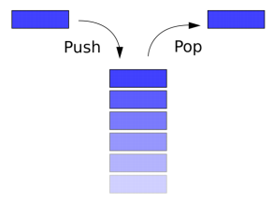
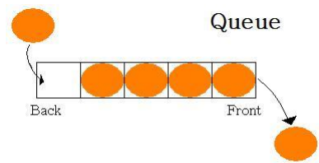
Stack and Queue
Uses of stacks?
  Implement recursive algorithms
  Compiling and running programs
  Backtracking algorithms like constraint satisfaction
  (e.g. Sudoku(数独))
Uses of queues?
  Website requests
  Simulations or game engines
  Expanding algorithms like Dijkstra’s

Slide 4
Queue – FIFO principle
A queue is a collection of objects that are inserted and removed according to the first-in, first-out (FIFO) principle

Slide 5
Queue - Basic Operations
enqueue (e)
dequeue ()

Slide 6
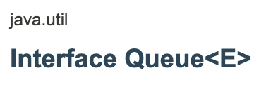
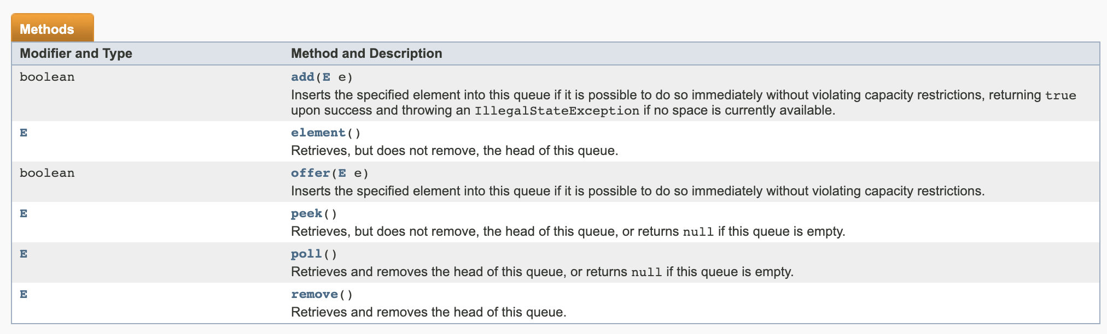
Queue in Java
Queue<Integer> q = new Queue<Integer>
Queue<Integer> q = new LinkedList<Integer>()
enqueue
dequeue

Slide 7
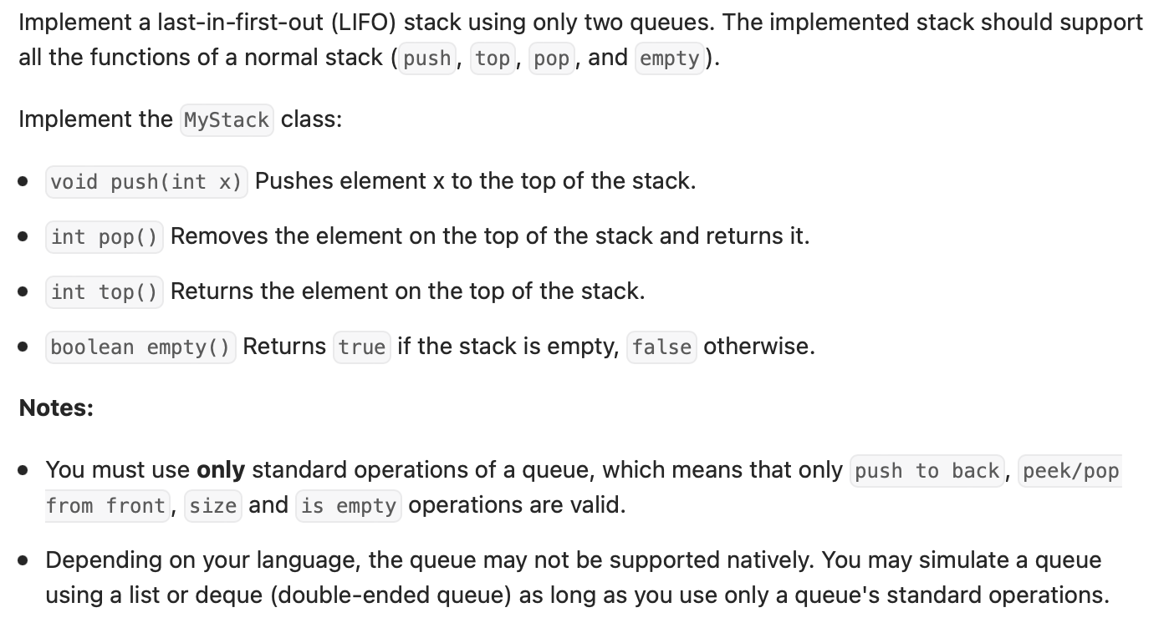
Exercise 1: implement stack using queues
Using two queues to implement a stack.

Slide 8
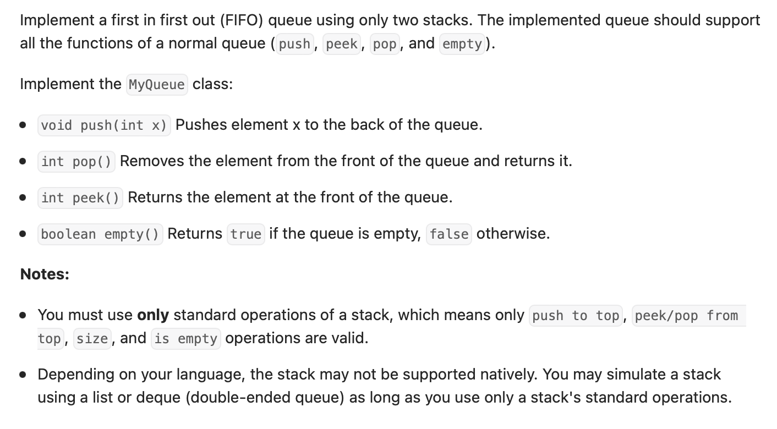
Exercise 2: implement queue using stacks

Slide 9
Exercise 3: Josephus Problem
There are N people (1-N)standing in a circle waiting to be executed.
Player 1 starts and eliminates (k-1) players to the left of him. Then the k-th man is executed.
Then again, k-1 people are skipped and the k-th man is executed.
These moves are repeated until one player is left, who is given freedom.
The task is to choose the place in the initial circle so that you survive, given n and k.
Please find the template code for Josephus problem on BlackBoard and complete the function.

Slide 10
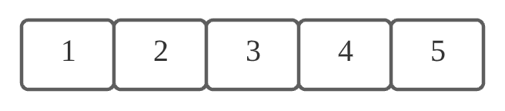
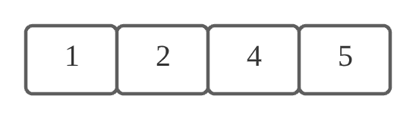
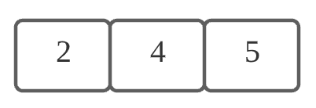
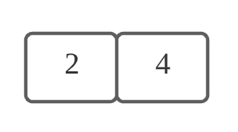
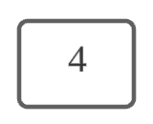
Josephus Problem Example (n = 5 and k = 3)
Removed Item: 3
Removed Item: 1
Removed Item: 5
Removed Item: 2

Slide 11
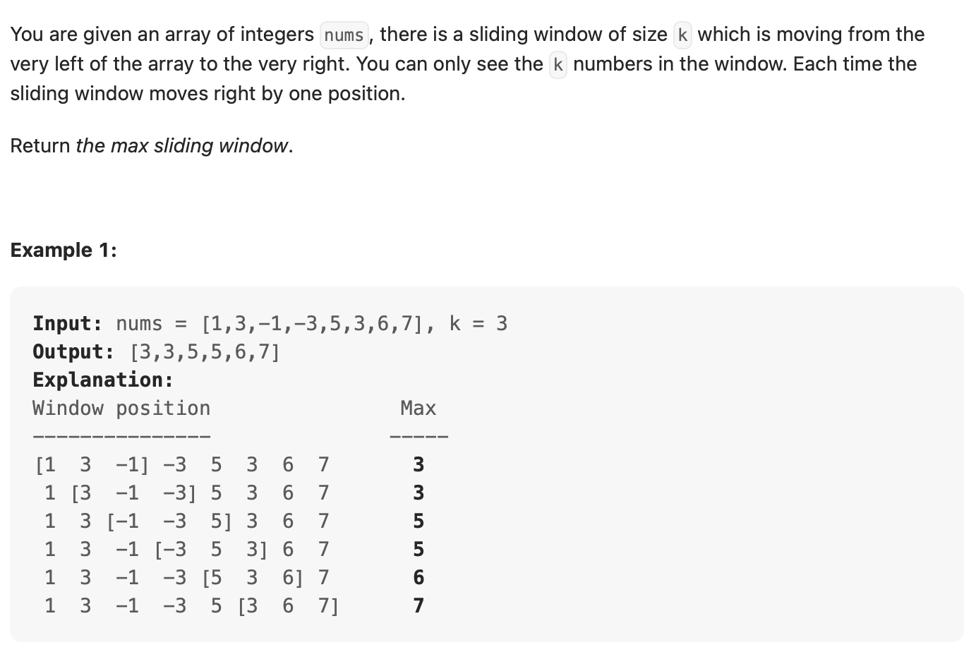
Exercise 4: Sliding Windows

